Slide 1
Introduction to Engineering Management
Engineering and Management

Slide 2
Textbook
Managing Engineering and Technology, Daniel L. Babcock and Lucy C. Morse
Publisher: Prentice Hall India Pvt. Ltd.
Reference Books:
• Engineering Management- Gupta-S. Chand publications
• Industrial engineering and Organization Management- Dr. S.K. Sharma, Savita Sharma
• A new American TQM- Four Practical in Management – Shoji Shiba
• Management , J.A.F Stoner, R.E. Freeman & D. R. Gilbert, 1995, prentice Hall
• Management – A global perspective, International edition , 1994, McGraw-Hill

Slide 3
Origins of Engineering
The words engineer and ingenious both stem from the Latin ingenium, which meant a talent, natural capacity, or clever invention.
Early applications of “clever inventions” often were military ones, and ingeniarius became one of several words applied to builders of such “ingenious” military machines.
Talent, natural capacity, or clever invention.

Slide 4
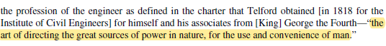
Engineering as a Profession
Engineer’s Council for Professional Development (ECPD), 1979 the precursor of ABET, the Accrediting Board of Engineering and Technology defined engineering as
the profession in which a knowledge of the mathematical and natural sciences gained by study, experience, and practice is applied with judgment to develop ways to utilize, economically, the materials and forces of the nature for the benefit of mankind.

Slide 5
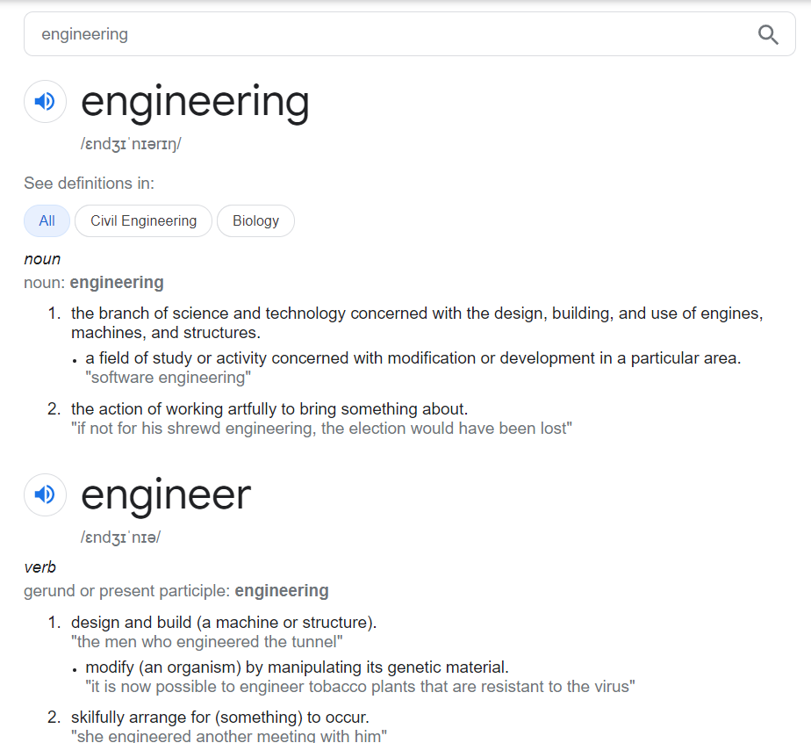
What Engineers Do

Slide 6
An engineer is a practitioner of engineering, concerned with applying scientific knowledge, mathematics, and ingenuity to develop solutions for technical, societal and commercial problems.
Engineers design materials, structures, and systems while considering the limitations imposed by practicality, regulation, safety, and cost.

Slide 7
Engineering has been differentiated from other academic paths by the need for people to logically apply quantifiable principles.
Academic knowledge, practical training, experience, and work-study are all avenues to becoming an engineer.
The key attribute for engineers is the direct application of that knowledge and experience.
Many engineering applications require cross-pollination or integration of multiple disciplines.
The previous focusing on a specialty is not as important as being able to communicate and team with others.
Flexibility and interpersonal skills will be the hallmark of the new generation of engineering disciplines.

Slide 8
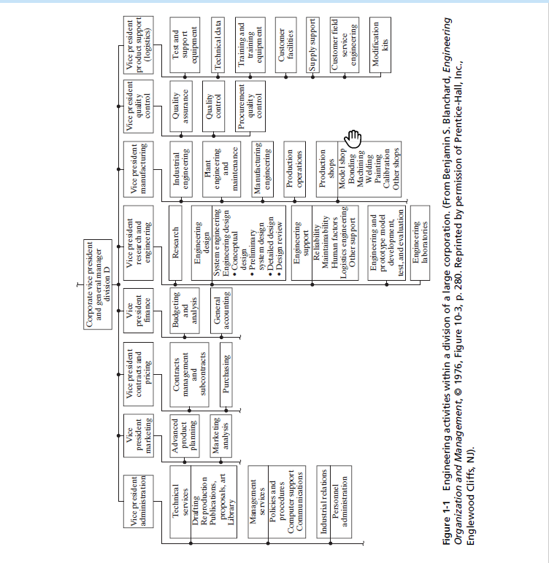

Slide 9
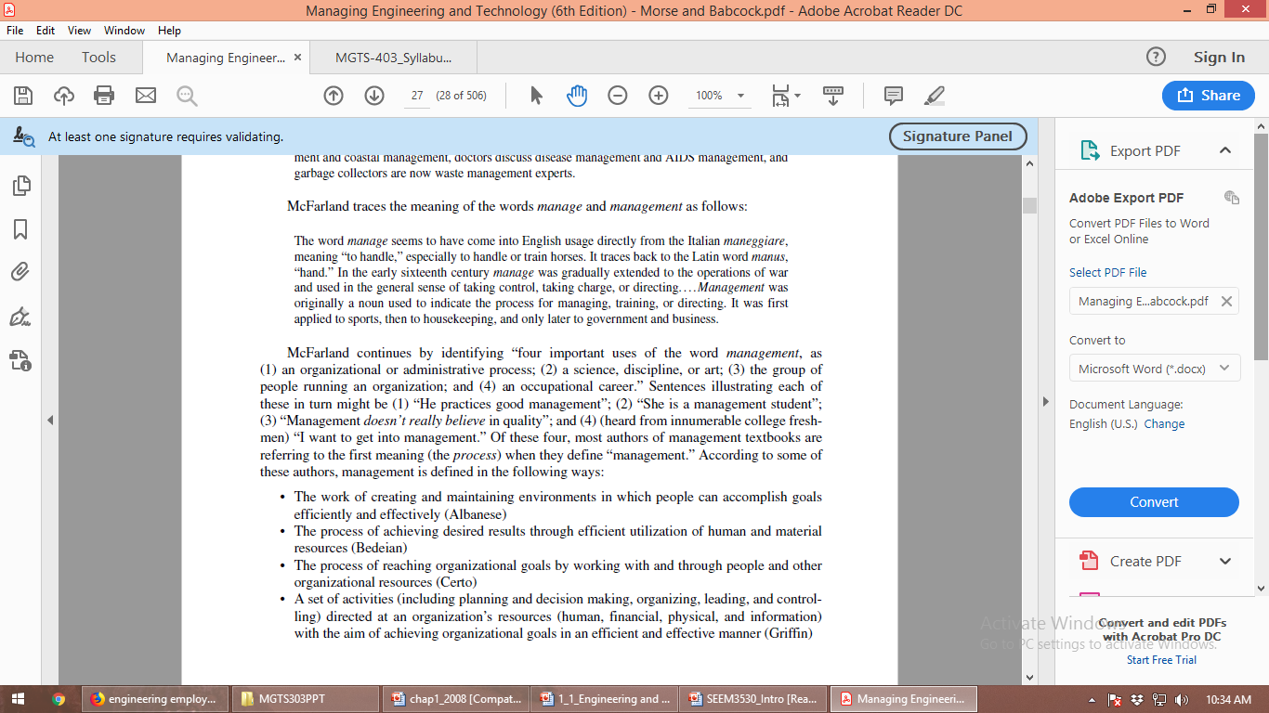
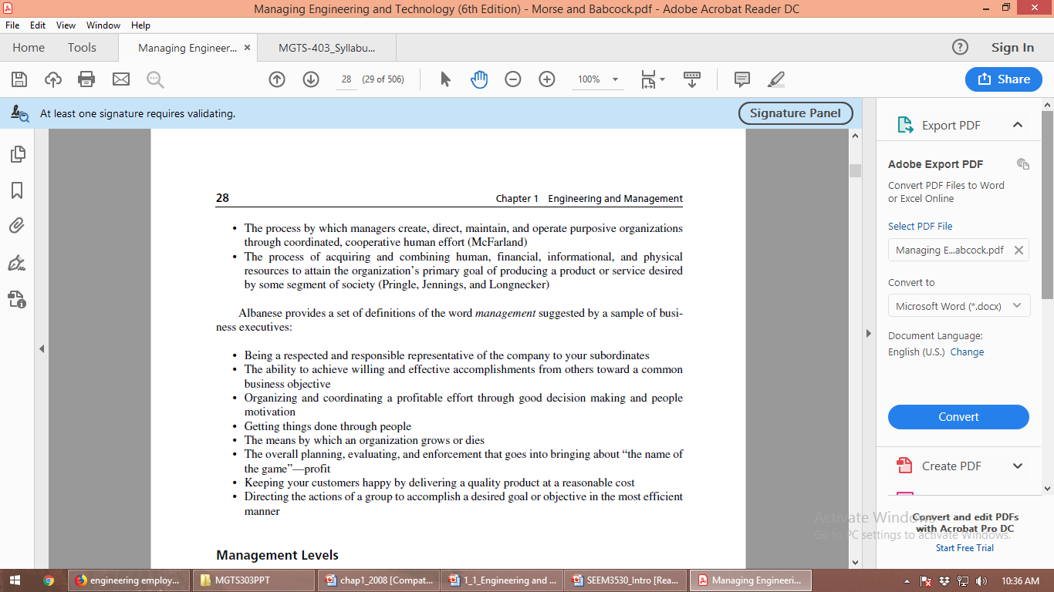
Management
Definitions

Slide 10
Organizations and Management
Organization is a deliberate structure of two or more people to accomplish some specific purpose or goal.
All organizations have some programs or method for achieving goals – a plan.
Organizations must also acquire and allocate resources necessary to achieve their goals.

Slide 11
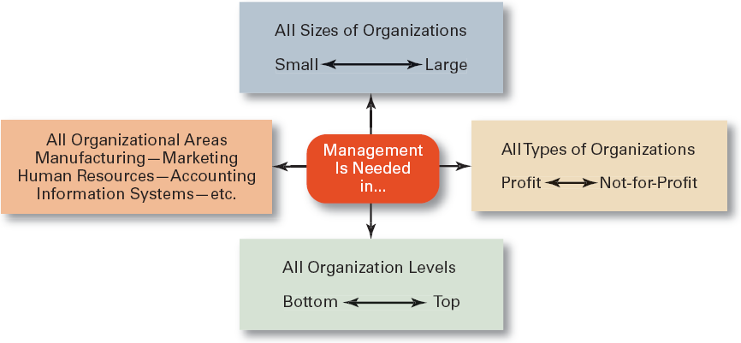

Slide 12
Managing Organizations
Management
The practice of consciously and continuously shaping organizations.
The process of planning, organizing, leading, and controlling the work of organization members and of using all available organizational resources to reach stated organizational goals.
Managers
People responsible for directing the efforts aimed at helping organizations achieve their goals.

Slide 13
Managerial performance
The measure of how efficient and effective a manager is (i.e. how well he/she determines and achieves appropriate objectives).
Managerial Concerns
Efficiency - “Doing things right”
Getting the most output for the least inputs
Effectiveness - “Doing the right things”
Attaining organizational goals

Slide 14
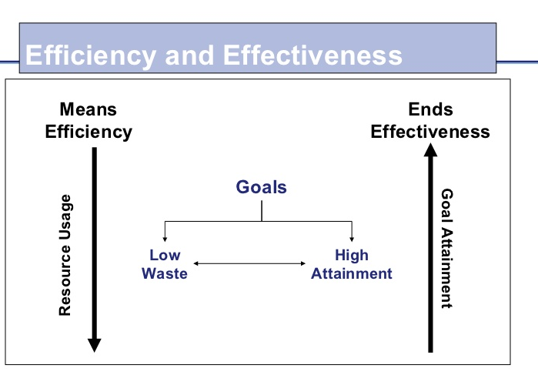

Slide 15
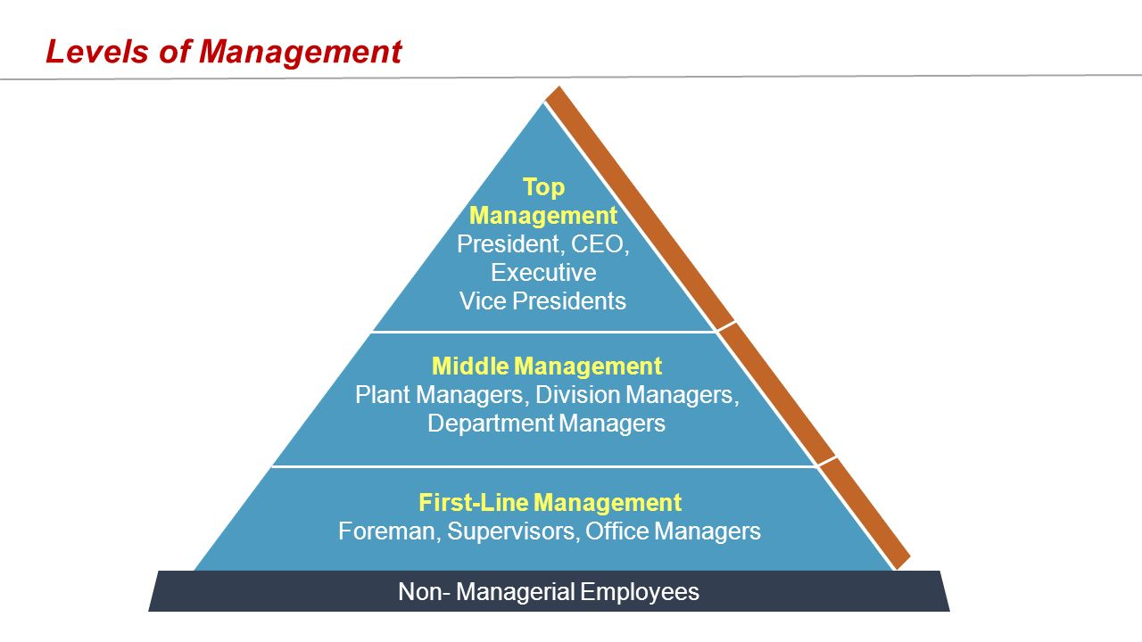
Levels of Management

Slide 16
Level
Type of Job
•
Directly supervise non-managers.
•
Carry out the plans and objectives of higher management using
the personnel and other resources assigned to them.
First-line Managers
•
Short-range operating plans governing what will be done
tomorrow or next week, assign tasks to their workers, supervise
the work that is done, and evaluate the performance of individual
workers.
•
Manage through other managers.
•
Make plans of intermediate range to achieve the long-range goals
set by top management, establish departmental policies, and
evaluate the performance of subordinate work units and their
Middle Management
managers.
•
Provide and integrating and coordinating function so that the
short-range decisions and activities of first-line supervisory
groups can be orchestrated toward achievement of the long-range
goals of the enterprise.
•
Responsible for defining the character, mission, and objectives of
the enterprise.
•
Establish criteria for and review long-range plans.
Top Management
•
Evaluate the performance of major departments, and they evaluate
leading management personnel to gauge their readiness for
promotion to key executive positions.

Slide 17
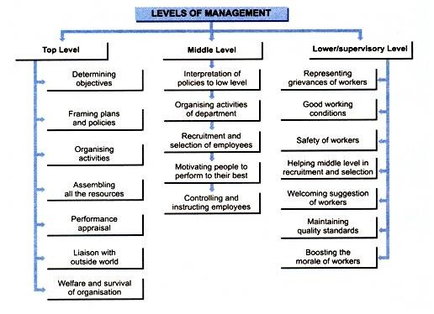

Slide 18
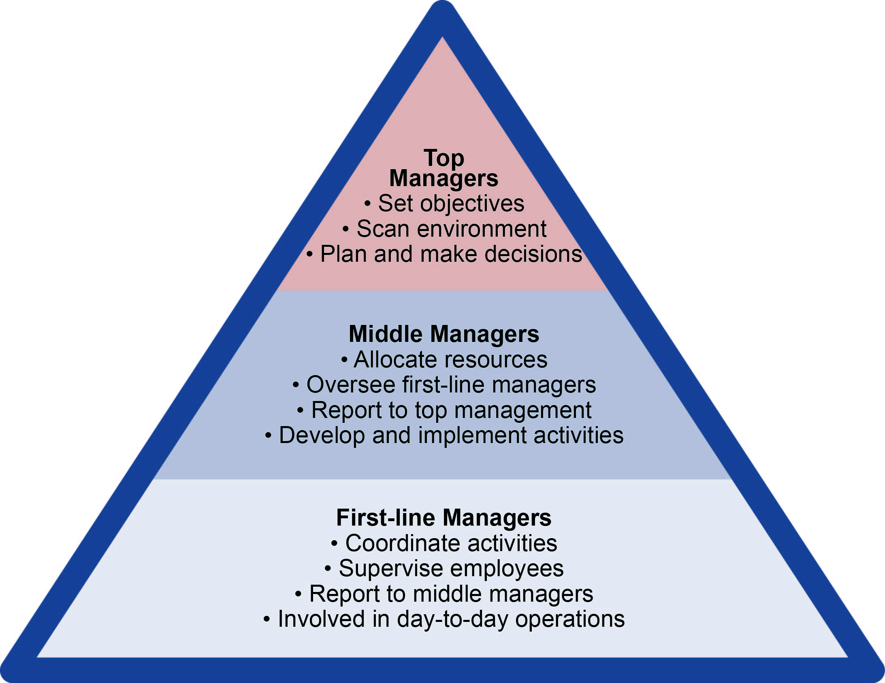

Slide 19
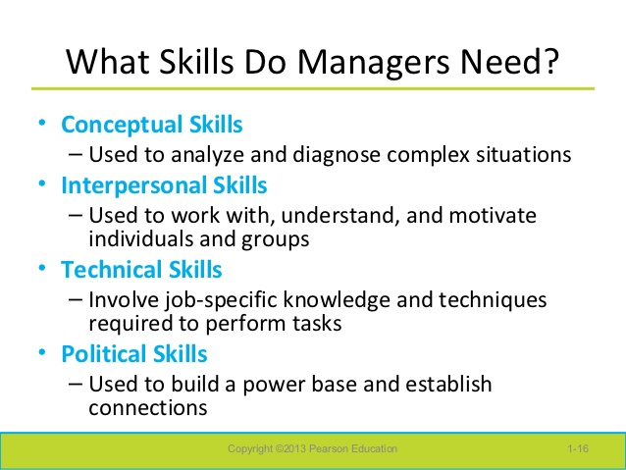
Managerial Skills are the knowledge and ability of the individuals in a managerial position to fulfill some specific management activities or tasks.
According to American social and organizational psychologist Robert Katz, the three basic types of management skills include technical, interpersonal, and conceptual.

Slide 20
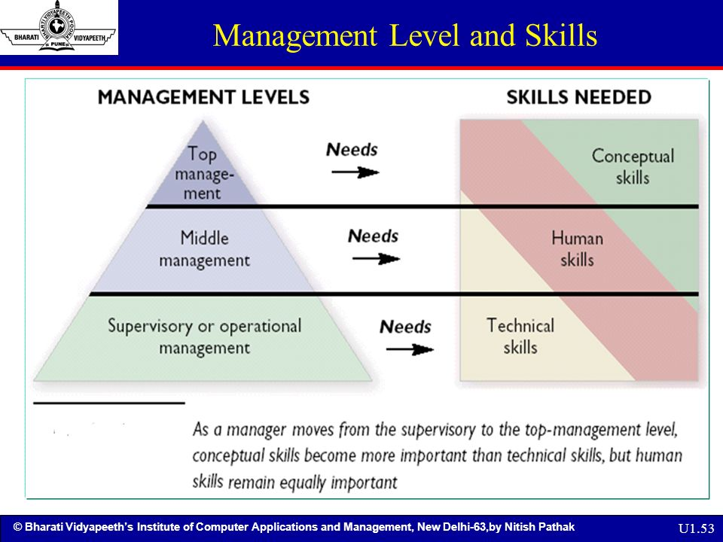

Slide 21
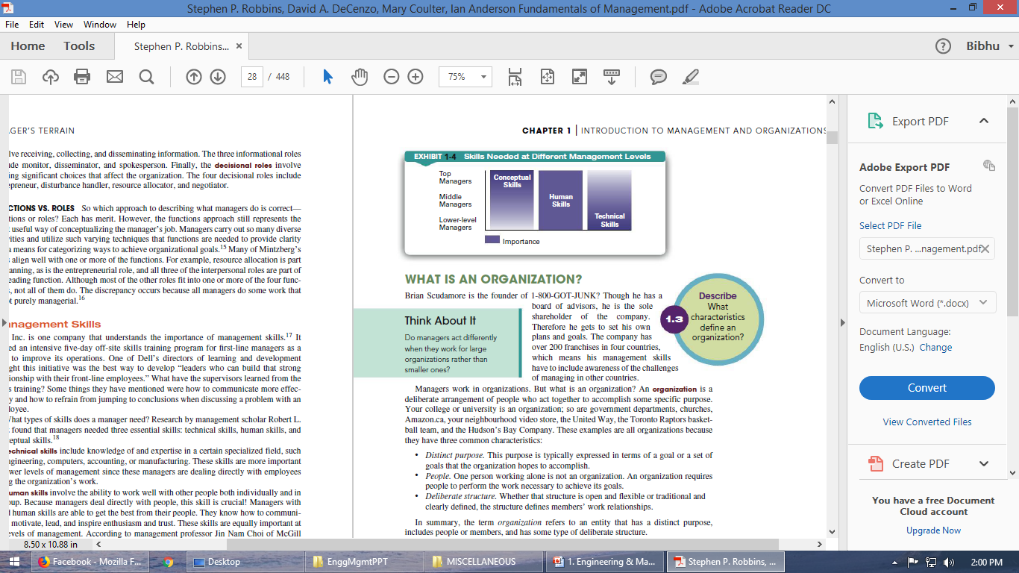
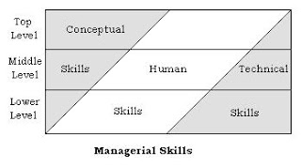
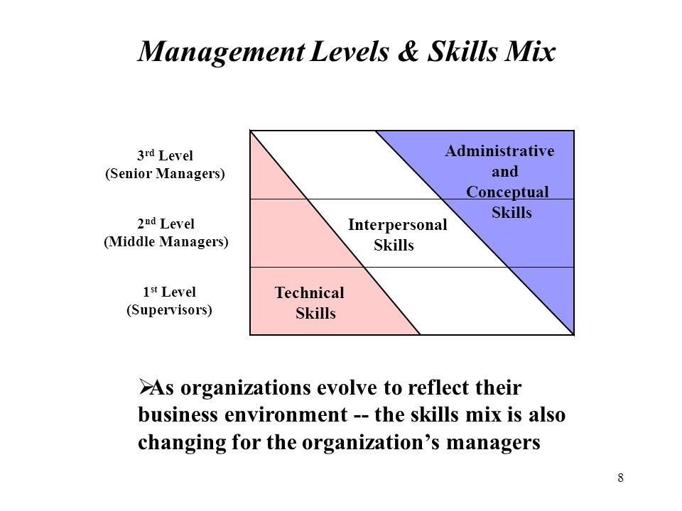

Slide 22
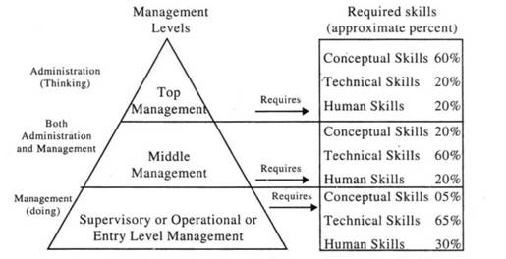
The management function may be divided into two categories: (1) administrative management and (2) operative management. The upper level of management is usually called administrative management and the lower level is known as operative management.

Slide 23
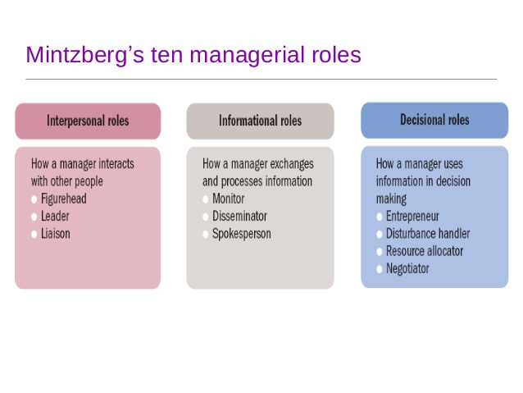
Managerial Roles

Slide 24
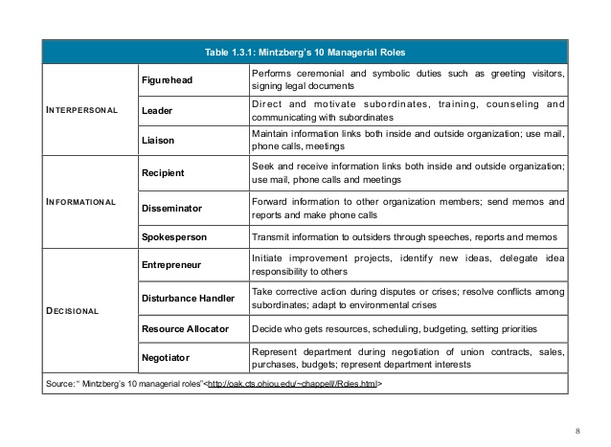

Slide 25
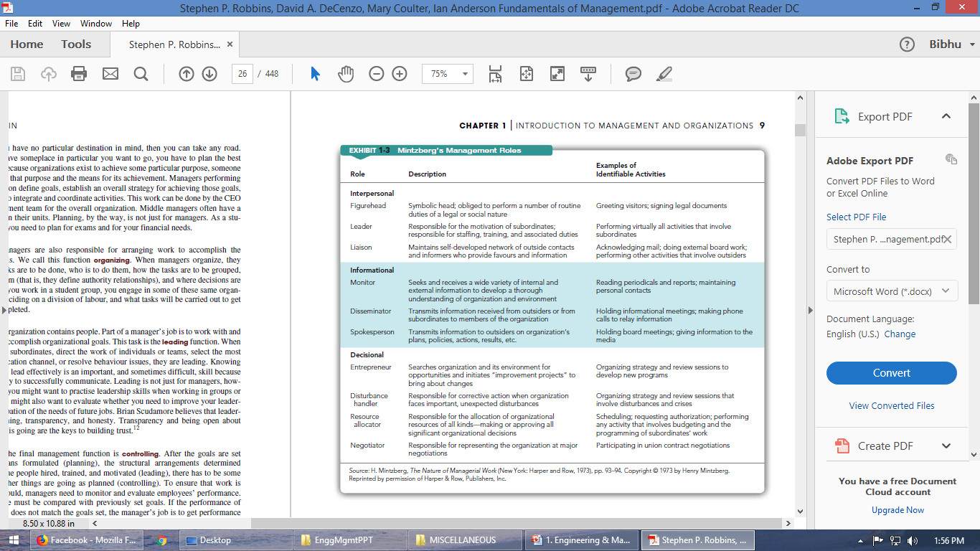

Slide 26
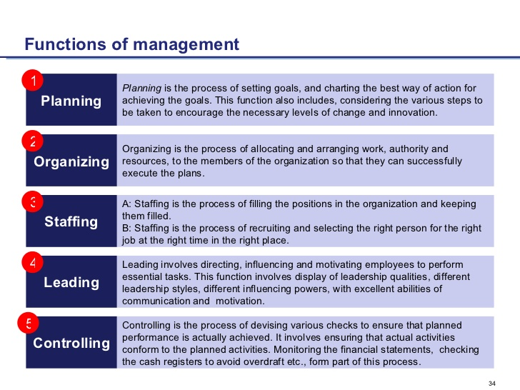
Functions of Managers

Slide 27
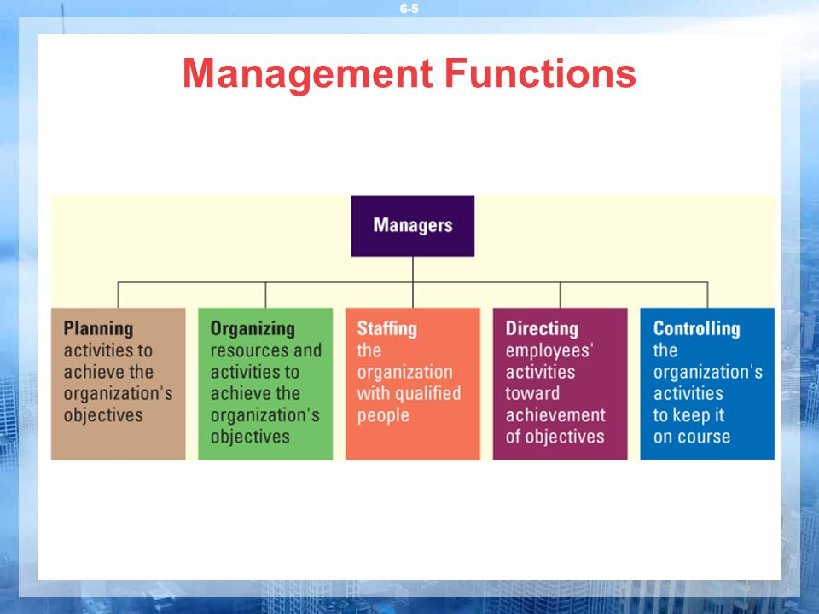
Notes:
https://www.slideshare.net/HashmatUllah1/chap-1-introduction-to-management

Slide 28
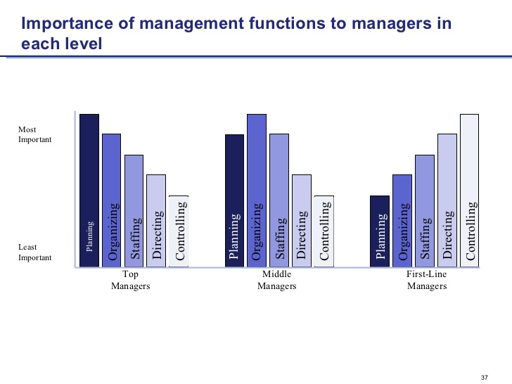

Slide 29
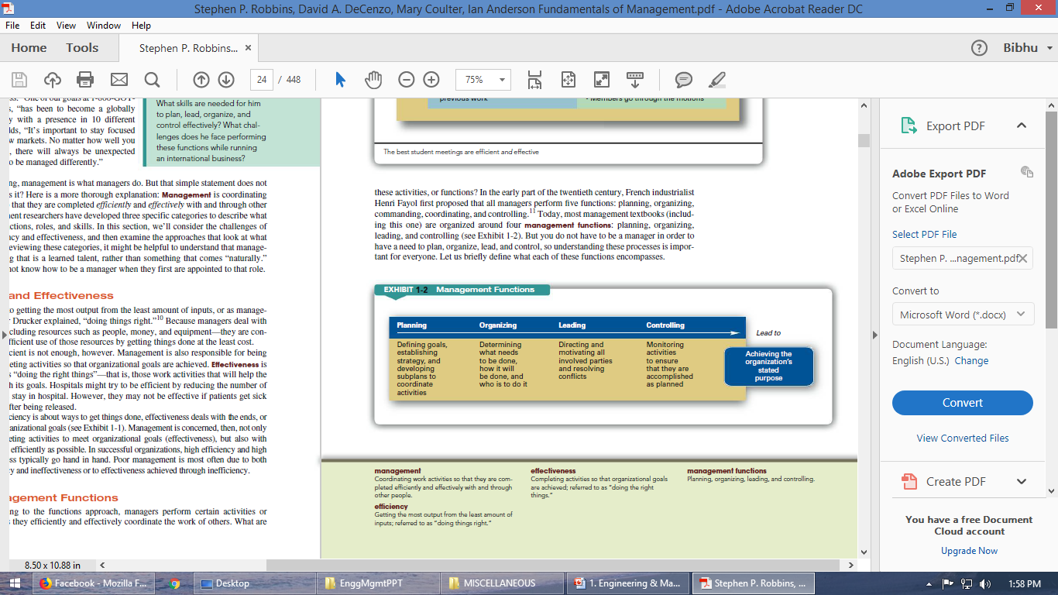

Slide 30
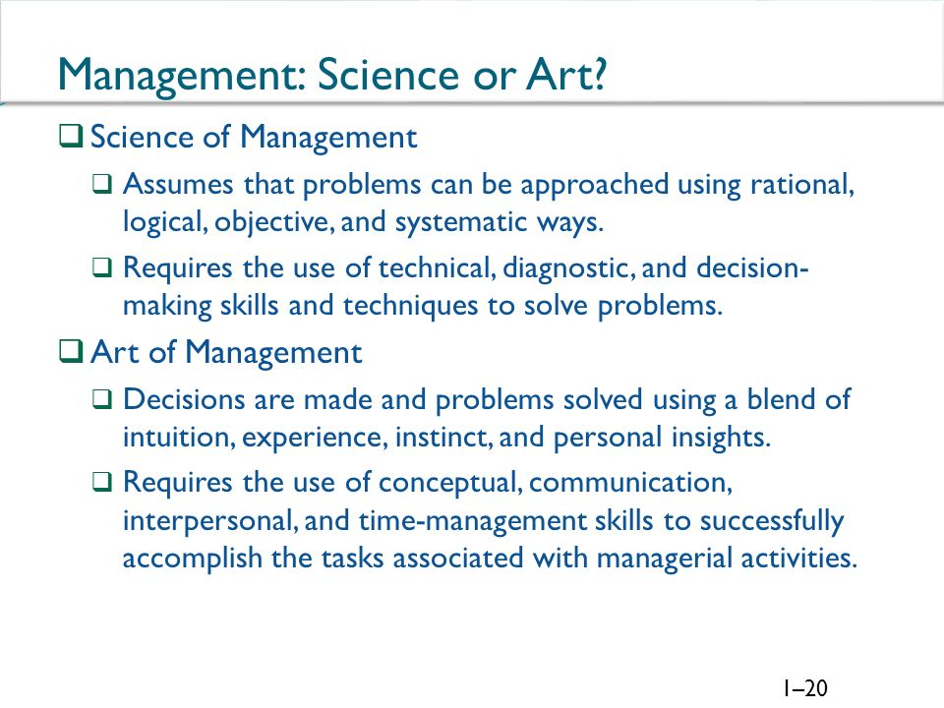

Slide 31
Management is both art and science.
Management is called an art because managing requires certain skills which are personal possessions of managers. Science provides the knowledge & art deals with the application of knowledge and skills. A manager to be successful in his profession must acquire the knowledge of science & the art of applying it.

Slide 32
Engineering Management
The direct supervision of engineers or of engineering functions (such as research and design activities).
“Engineering of management” – the application of quantitative methods and techniques to the practice of management (often called “management science”).

Slide 33
Engineering Management versus “Ordinary” Management
The engineering manager is distinguished from other managers because he/she possesses both an ability to apply engineering principles and a skill in organizing and directing people and projects.
He/she is uniquely qualified for two types of jobs: the management of technical functions (such as design or production) in almost any enterprise, or the management of broader functions (such as marketing or top management) in a high-technology enterprise.

Slide 34
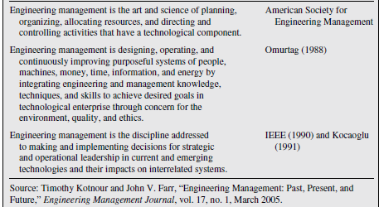

Slide 35
Need for Engineers in Management
High-technology enterprises make a business of doing things that have never been done before.
Extensive planning needed considering the uncertainties and feasibility of products or outcome.
Recruitment and evaluation of technical personnel.
Better understand the nature and motivation of technical specialist and can gain their respect, confidence, and loyalty.

Slide 36
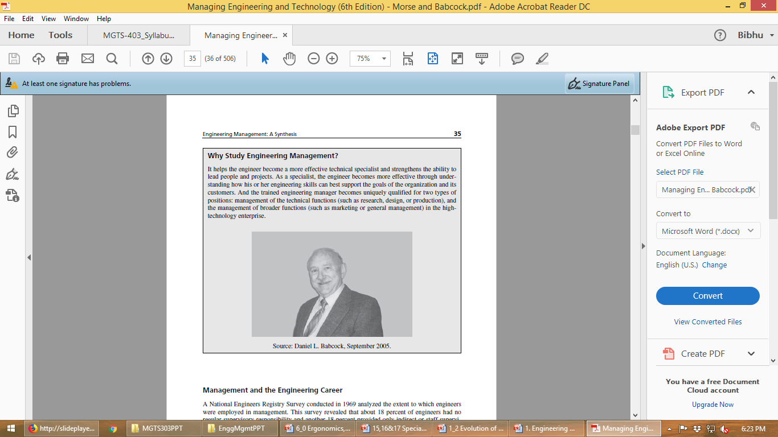
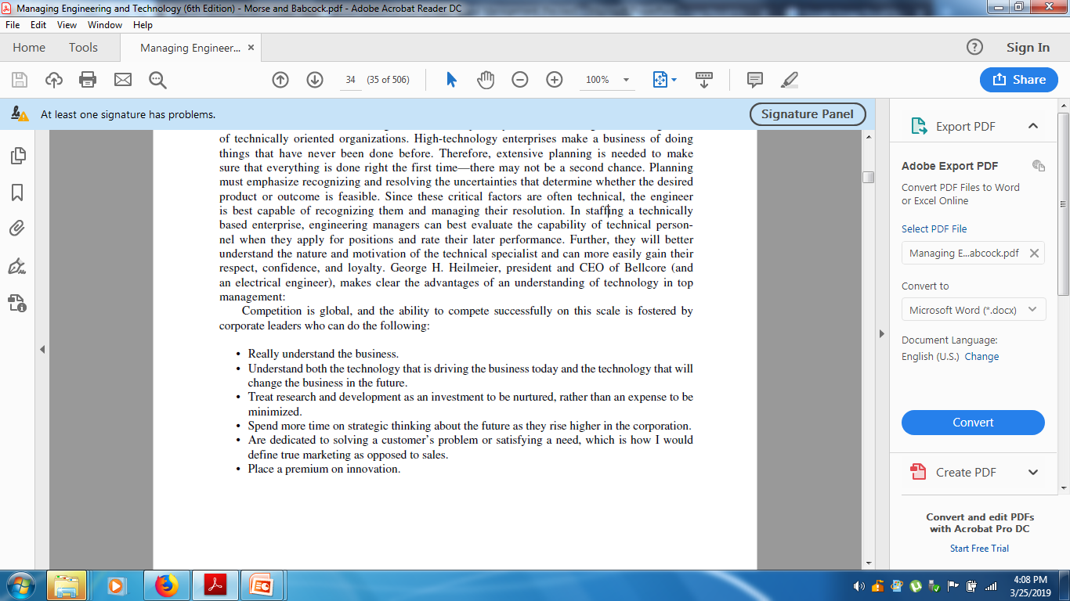

Slide 37
